Slide 1
Enriching Your Child at Home
Port Washington public schools
November 17, 2015

Slide 2
Introductions & Opening Remarks
Dr. Wafa Westervelt
Assistant Superintendent for Curriculum, Instruction, & Assessment

Slide 3
Enrichment through Art & Nature
Alyssa Toscano
Kindergarten Educator
Guggenheim Elementary School

Slide 4

Enrichment through Nature
        Learning through the senses
Using the senses to explore
Observation skills: looking closer
Collecting, classifying and sorting
Building curiosity and creativity
Inquiry: scientific investigation
Imaginative play
Unstructured and spontaneous

Slide 5
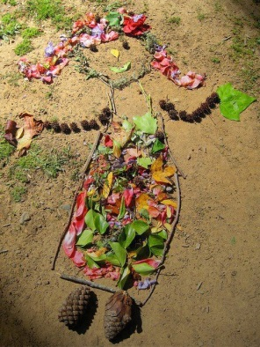
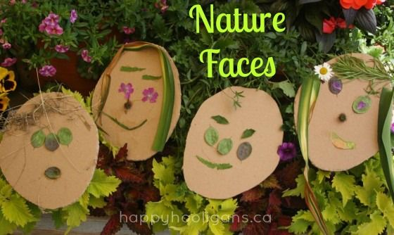
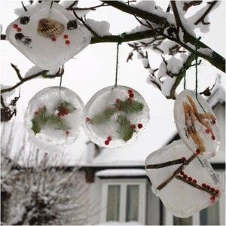
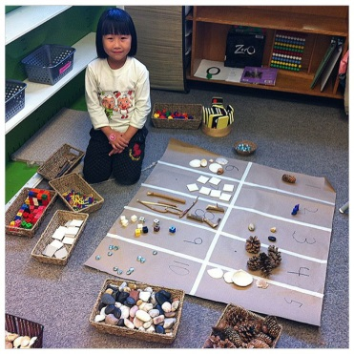
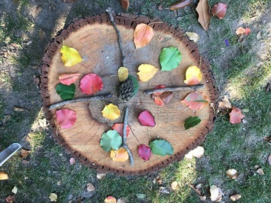
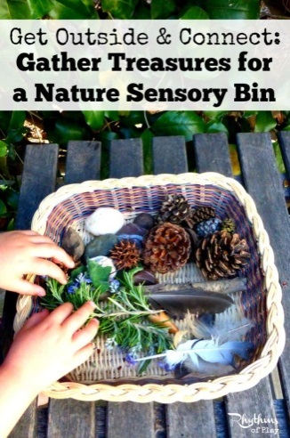
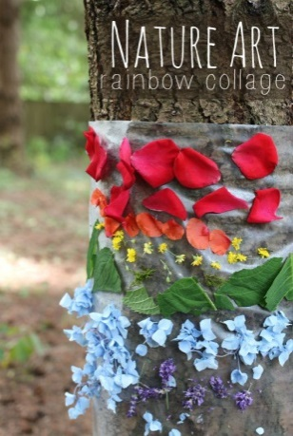
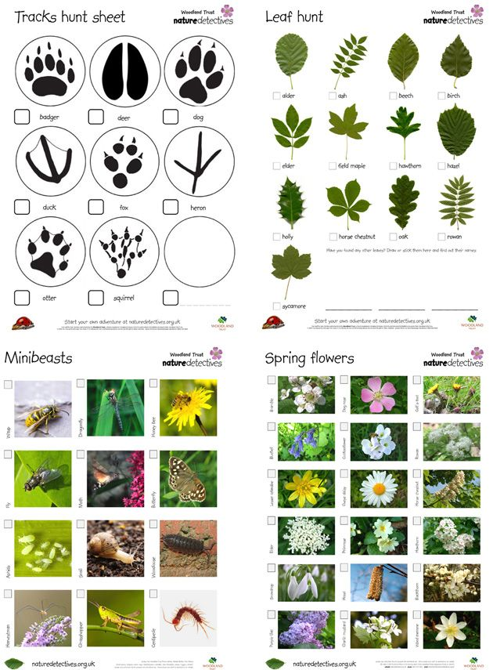
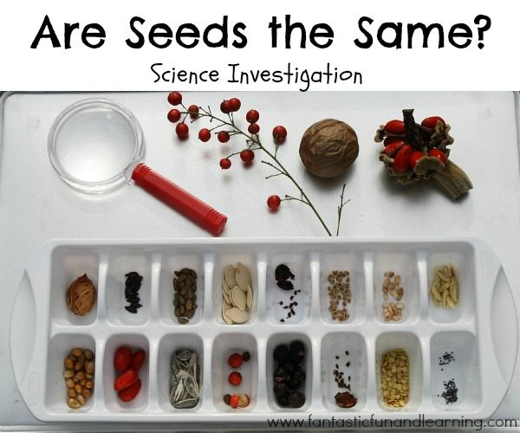
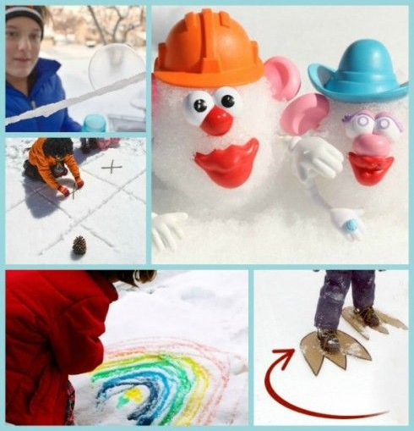
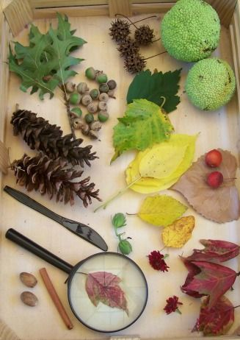
Enrichment through Nature

Slide 6


Nature Themed Literature
The Curious Garden by Peter Brown
The Wump World by Bill Pete
Miss Rumphius by Barbara Cooney
The Little House by Virginia Lee Burton
On Meadowview Street by Henry Cole
and then it’s spring by Julie Fogliano
Just a Dream by Chris Van Allsburg
Owl Moon by Jane Yolen
Weslandia by Paul Fleischman
The Tree by Dana Lyons
Each Living Thing by Joanne Ryder
A Seed Is Sleepy by Dianna Hutts Aston
Not Your Typical Book About the Environment by Elin Kelsey
All the World by Liz Gartan Scanlon
The Carrot Seed by Ruth Krauss
Crab Moon by Ruth Horowitz
Hey, Little Ant by Phillip M. Hoose
Snowflake Bentley by Jacqueline Briggs Martin
Diane L. Burns Nature series: Birds nest and eggs; Caterpillars, Bugs and Butterflies; Track, Scats and Signs; Berries, Nuts and Seeds; Snakes, Salamander and Lizards; Trees, Leaves and Bark; Frogs Toads and Turtles
Winter Tree’s by Carole Grober
When Winter Comes by Nancy Van Lann
Animals in Winter by Henrietta Bancroft
Feel the Wind by Arthur Dorros

Slide 7
Enrichment Through
Digital Technology
Marisa Johnson
First Grade Educator
Sousa Elementary

Slide 8

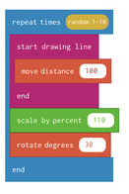
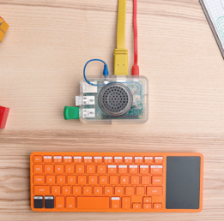
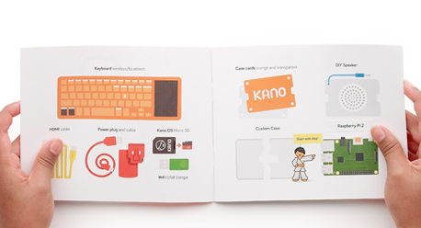


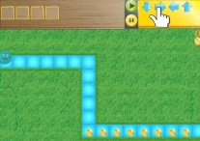
Coding
“Coding is the new literacy. To thrive is tomorrow’s society young people must learn to design, create and express themselves in digital technologies.”
– Mitchel Resnick, Professor at MIT
Apps
Hopscotch
Make your own version of popular games that anyone can play on their iPad or iPhone.
Learn coding concepts and vocabulary.
Easy to follow video tutorials within the app. You can watch the video as you create.
Scratch Jr. / Scratch
Program their own interactive stories and games, solve problems and design projects.
Kodable
A very user friendly computer programming foundation for young children.
Websites
Code.org
Computer Software/Hardware
Kano Kit ($)
“All in one kit: books, bits, apps, games,
challenges and a global community.”
“The simplest way to start coding.”
“Draw art, make music, code games like
Minecraft, Snake and Pong.”
(as stated on us.kano.me)

Slide 9
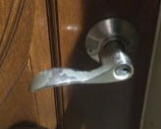
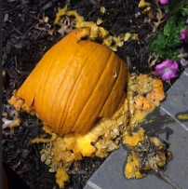
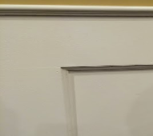








Enrich Learning With Photos and Video
1. Reflecting on learning- Use the video camera or audio recorder on a smart phone to create short reflections on what they have learned during the week.
2. Documenting a process- Take pictures and or videos to document the process of a project or experiment.
3. Capturing real-world examples- Connect school lessons to real world experiences. Capture pictures as they see them during a walk around town, in your home or on a family trip.
Simple Food Angles Money
Machines Chains
4. E-portfolio- Create an electronic portfolio or scrapbook of the school year. These photos and videos can be uploaded to a flash drive, private blog (Blogger) or the GoogleApp https://sites.google.com/site/eportfolioapps/overview
5. Comics- With, create a comic strip or graphic novel using your own photos.
6. QR Codes- With a website like Vocaroo, children can record their voice and get a QR code for their recording. They print out the QR code to create a scavenger hunt or book review.
Book Creator
Hopscotch Pals
Puppet
www.tinytap.it/
Strip Designer Comics Head Comic Life

Slide 10





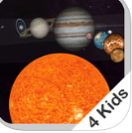
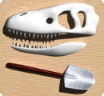

Discovery and Exploration Apps
DIY Lake Science
Investigate lakes and other freshwater ecosystems anywhere you go! Conduct twelve hands-on activities, view fascinating videos, and explore how lakes change in the Under the Lake simulation.
Classify It!
A new game to test your knowledge of how various organisms can be sorted and grouped.
NASA Visualization Explorer
Get stories about NASA's exploration of the Earth, sun, moon, planets and universe delivered right to your iOS device.
ISS Live
Get info about the International Space Station, interact with live streaming data, take virtual 3D tours of the Mission Control Center and ISS.
Sky Guide
Just hold it to the sky to automatically find constellations, planets, satellites and more.
Solar System 3D for kids
Take a journey to our solar system.
Dino Digger
Dig up dinosaur bones, build them into interactive 3D skeletons, and then bring your dino bones to life.
The Human Body
Explore a working model of the body. Every part is interactive.

Slide 11






Language Arts and Literacy
Valuable Websites and Apps
NEWSELA
Create a free parent account for access to kid friendly current events articles in multiple reading levels. There is a large selection of articles in Spanish. Children read and answer questions about the articles and parents can monitor their child’s progress. https://newsela.com/
Epic!
Children’s books of all levels including Read-to-me audio versions. A variety of bilingual Spanish books is also available. Teachers and Librarians can create free accounts however a parent account is $4.99. https://www.getepic.com/
Book Creator Story Creator Our Story
Use photos, clip art, personal drawings, voice, backgrounds and more to create your own story book.
Evernote Skitch
Photograph, document, record and organize your ideas and projects.

Slide 12



Engineering, Music and Art
Valuable Websites
Engineering
PBS Kids Design Squad
Hands on engineering, science and technology activities. http://pbskids.org/designsquad/
Try Engineering
Play games that allow you to design and virtually engineer a bionic arm, a solar car, a parachute and more. TryEngineering.org
Dream up the Future
This website from the American Society for Engineering Education has activity ideas, resources, outreach program and contest information. http://teachers.egfi-k12.org/
Music and Arts
Online games, activity ideas and parent resources. http://www.pbs.org/parents/education/music-arts/music/
Extension and enrichment activities through music and art. https://www.teachervision.com/activity/resource/5855.html

Slide 13

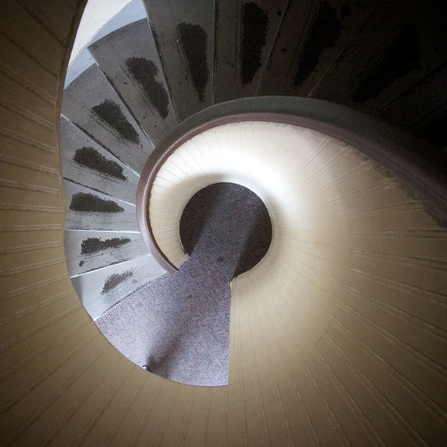
Fostering Curiosity In Your Child
By: Eric Sutz, Grade 5
& Ruth Diaz, Math Resource Educators
Salem Elementary

Slide 14

What is Curiosity?
Why is it important in today’s world?

Slide 15
How Can You Foster Curiosity in your Child?
Wonder List
Interest journal
Questions

Slide 16
Questions that Can Extend/
Sustain Curiosity
How did you come up with that idea?
How did you figure it out?
Do you think that will always work? Why?
When do you think it might not work?
What happened when…?
What happens if…?
How would you do that?

Slide 17

Using a household item:
The calendar

Slide 18
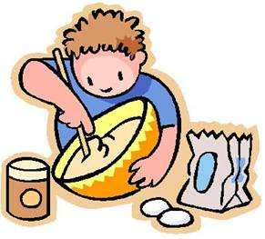
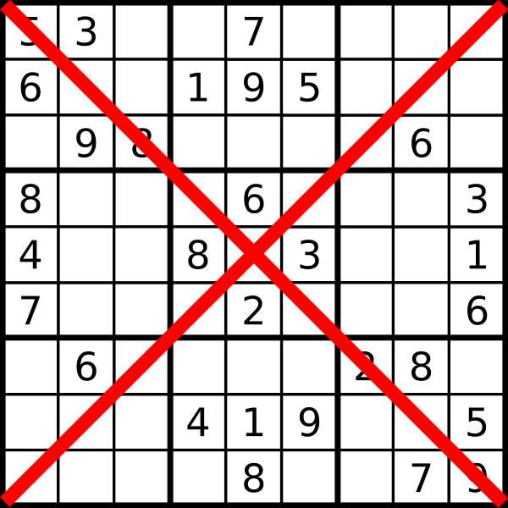
Enriching Activities to Develop
Mathematical Concepts
Cooking
Travel
Eating Out
Shopping
Family Games
    Jenga
    Sudoku
    Rush Hour
    Tower of Hannoi

Slide 19

Enrichment through Questioning & Games
Regina McLean
Manorhaven & Salem PEP Educator

Slide 20
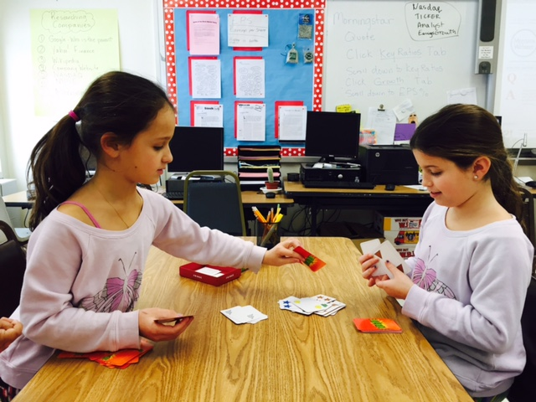
Why Games?
Develop Problem Solving Skills.
Provide a concrete, hands-on experience that children need in order to be successful in abstract reasoning activities.
Give practice in planning and strategizing that can translate directly to school.
They’re fun! When something is fun, the amygdala in the brain is activated in a positive way and this aids long term storage in the brain.

Slide 21
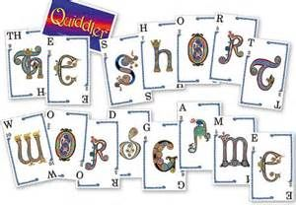
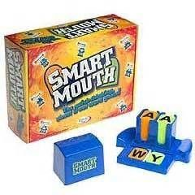
Games to develop verbal reasoning and language
Smart Mouth
Quiddler (also Online Daily Puzzle)
Bananagrams
Apples to Apples / Jr*
Picwits
Scrabble / Scrabble Jr.*
Scattergories

Slide 22
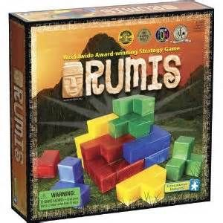
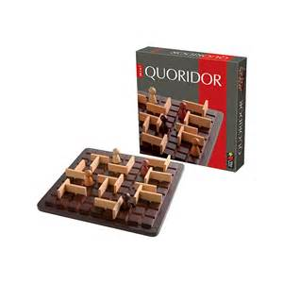
Games to develop spatial reasoning
Solitary Play
Rush Hour and Rush Hour Junior
Tipover
Group Play
Batik
Blokus
Rumis
QBITZ
Othello
Quoridor
Rush Hour Shift
Tower of Hanoi
Notes:
Blokus-
Rumis 3-d version of blockus. Extremely popular with my students. 2-4 players
Quoridor- simple strategy game. Try to get your piece to the other side. Your opponent can place fences to block you and you the same. Quick thinking for two and very fun with four players.

Slide 23
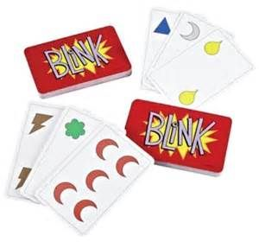
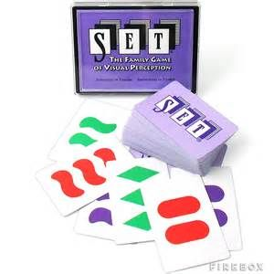
Games to develop Mathematical Reasoning
Blink
Set​ (also Online Daily Puzzle and APP)
Quirkle
Mastermind / Jr*
​24​
Clue ​
Guess Who?​*​
Notes:
Blink- very fast and very portable. Develops observational skills and builds hand eye coordination. Because of the fast nature of the game, It can be addictive. Great for all ages. Playing with younger children? Use fewer cards. Can be played with 2-4 players.
Set- no turn taking in this game. Builds Players look for three cards that have either all attributes the same or different. develops
Online version and new micro version fits in your pocket.

Slide 24
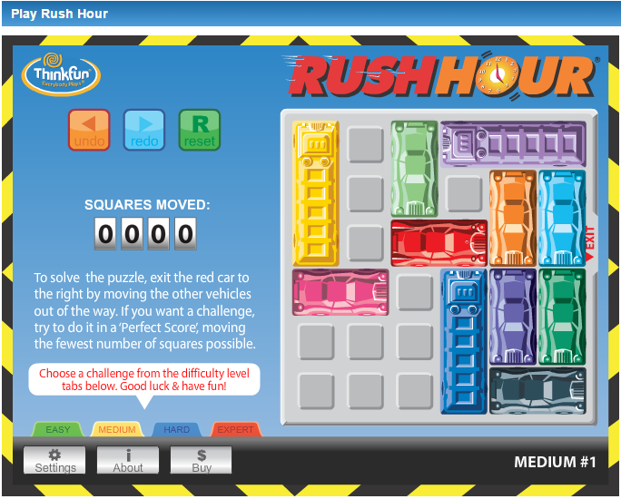
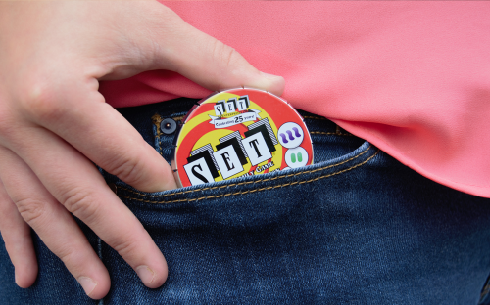
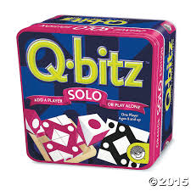
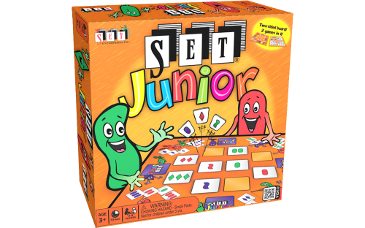
Many of these games come in a variety of versions:
Solo Versions
Travel Versions
Online Versions
Junior Versions
Tablet/Phone App Version

Slide 25
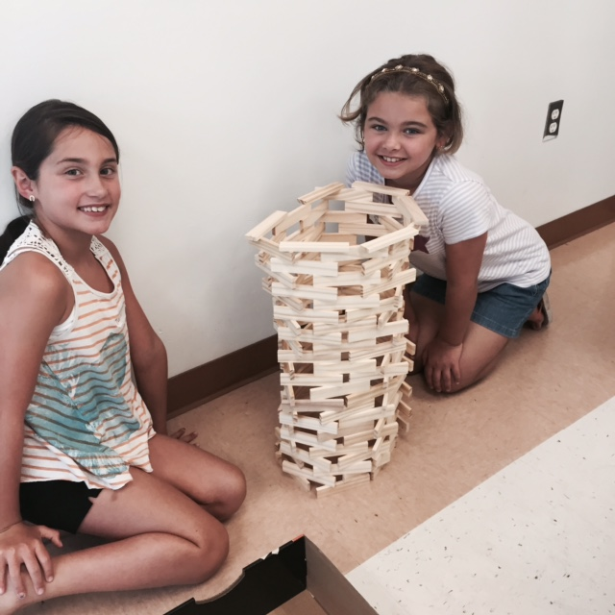
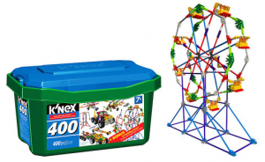
Not a game, but don’t forget these toys:
KEVA PLANKS
KNEX
LEGO

Slide 26
There are so many more games!
Find games that your child loves so they’ll want to play them over and over.
Dolphin Bookstore
Maddy’s Toy Shop
Think Fun http://www.thinkfun.com/
SetGame
http://www.setgame.com/
Mindware
http://www.mindware.com/

Slide 27

Stacey Susinno
Weber Science Educator
Enrichment Through Nature: Backyard Science

Slide 28

“If a child is to keep alive his inborn sense of wonder, he needs the companionship of at least one adult who can share it, rediscovering with him the joy, excitement, and mystery of the world we live in.”
~Rachel Carson
The Sense of Wonder
Science Enrichment for Adolescents
Stacey Susinno a Earth Science a Weber Middle School

Slide 29

Why continue enrichment opportunities?
As we know, experience can play a very important role in shaping the brain. Not only in the present but with respect to how kids are going to learn in the future.
Science suggests that it’s important for kids to be challenged and exposed to novelty in order to facilitate healthy development of brain systems that are important for things like self-regulation.
~Q&A: Plumbing The Mysteries Of The Teenage Brain
By Anya Kamenetz OCTOBER 8, 2014
http://ww2.kqed.org/mindshift/2014/10/08/qa-plumbing-the-mysteries-of-the-teenage-brain/

Slide 30
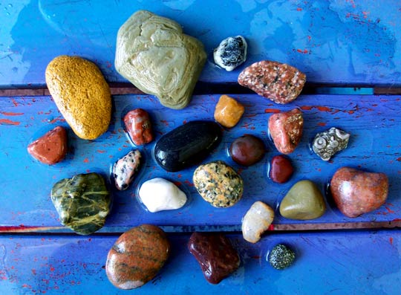
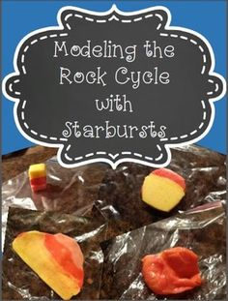
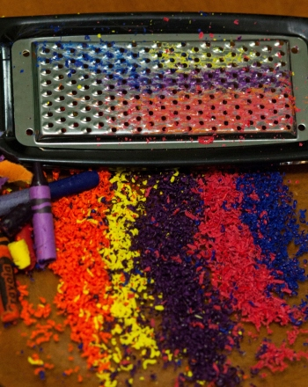
Field experience
In the back yard
NGSS: Dimension 3: Disciplinary Core Ideas Relate to the interests and life experiences of students or be connected to societal or personal concerns that require scientific or technological knowledge.
Rock Collecting:
Identify rocks and minerals
http://www.rockhounds.com/rockshop/rockkey/#Key
Rock Cycle Science Experiments
https://youtu.be/g93jXTUv_RQ
More geology projects:
http://www.education.com/science-fair/geology/

Slide 31
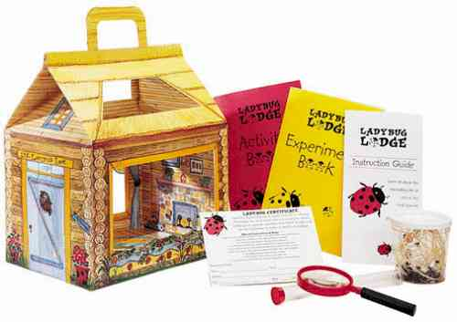

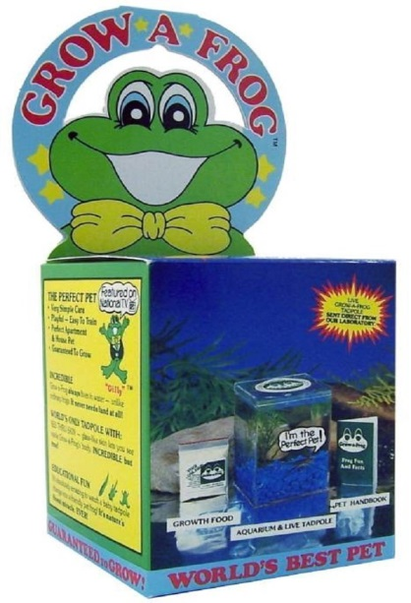
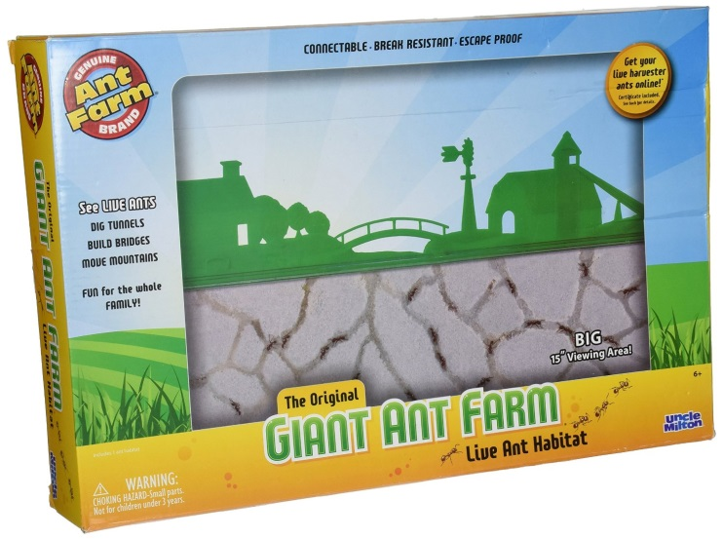
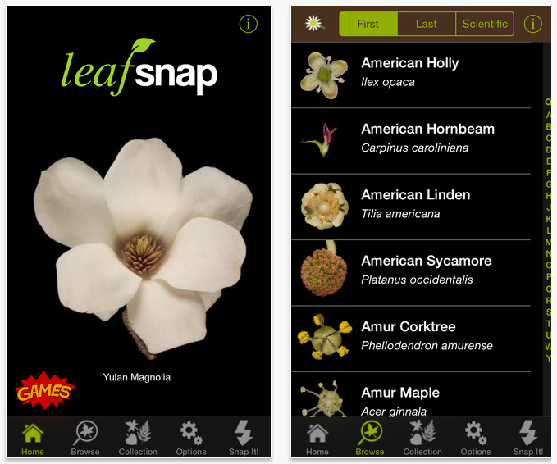
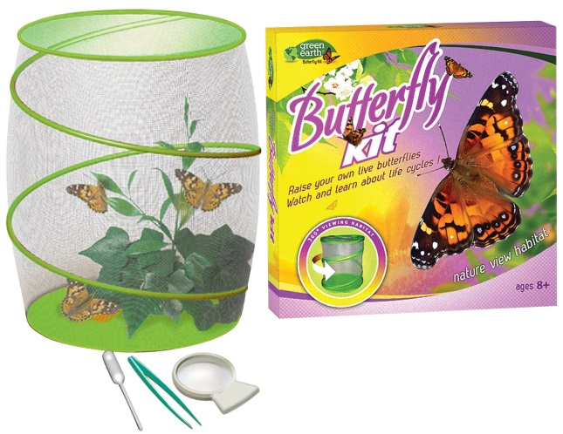
Field experience
Specimen identification and study

Slide 32
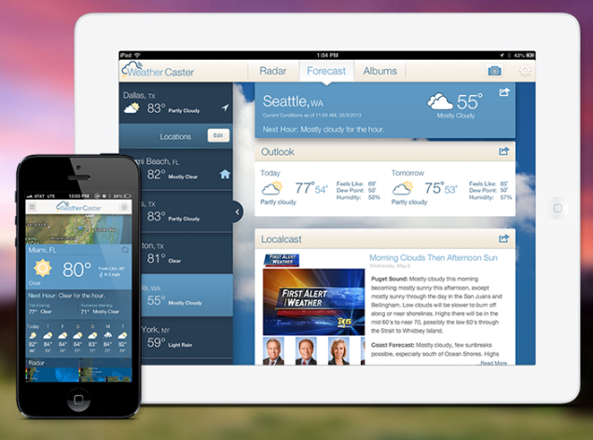
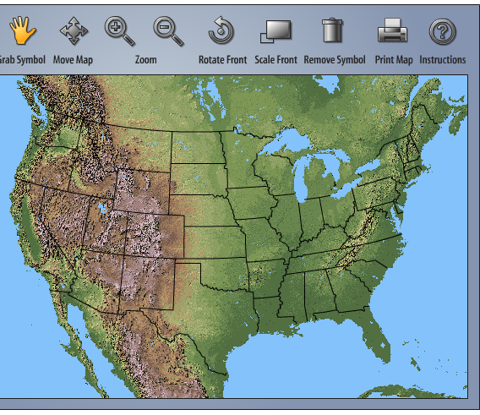

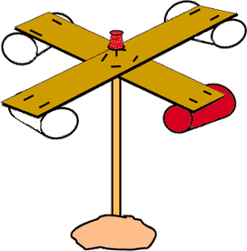
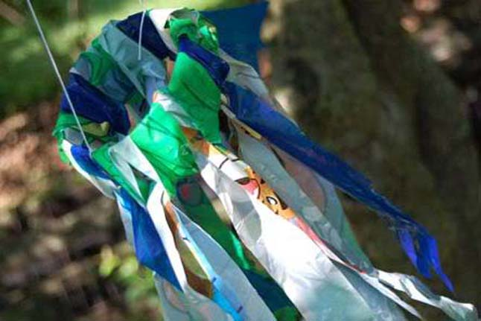
Weather
Create a weather map
Build a thermometer
http://www.glencoe.com/sec/science/activities/weather/
Build an anemometer
http://www.energyquest.ca.gov/projects/thermometer.html
Build a wind sock
http://www.pbs.org/parents/crafts-for-kids/windsock-craft/
More weather instrument
engineering Projects:
http://oceanservice.noaa.gov/education/for_fun/BuildyourownWeatherStation.pdf
https://www.teachengineering.org/view_activity.php?url=collection/cub_/activities/cub_energy2/cub_energy2_lesson07_activity1.xml

Slide 33

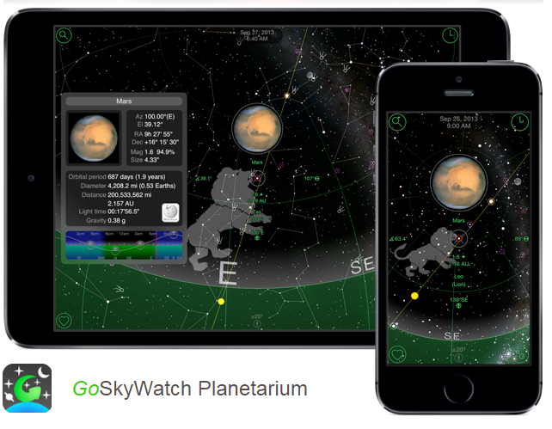
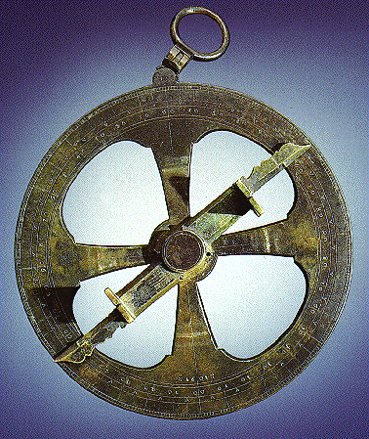

The night sky
Virtual Planetariums
Navigate with the stars:
http://oceanservice.noaa.gov/education/projects/makeyourownastrolabe.pdf
http://www.skymaps.com/downloads.html
http://www.skyviewcafe.com/
Upcoming events in your night sky
http://www.space.com/skywatching/
Current moon phase calendar http://www.moonconnection.com/moon_phases_calendar.phtml

Slide 34

More easy-to-do at home science experiments:
http://scifun.chem.wisc.edu/homeexpts/homeexpts.html
http://www.sciencekids.co.nz/experiments.html
http://www.buzzfeed.com/peggy/kids-science-experiments-that-adults-can-enjoy-too#.nvK6DOvMm
http://redtri.com/classic-science-experiments/

Slide 35

“Those who contemplate the beauty of the Earth find reserves of strength that will endure as long as life lasts”
~Rachel Carson
The Sense of Wonder

Slide 36

Eileen Mills
Schreiber English Chair/Educator
Engaging the high school student
  Can I have an enriching experience with a stressed-out teen?

Slide 37



Do you have 20 minutes?
Watch a Ted Talk!
A viral video phenomenon and a worldwide community of passionate, smart people who have an important story to share.

Slide 38
Some “Must Watch” Ted Talks
Sir Ken Robinson: “Do Schools Kill Creativity?”
Amy Cuddy: “Your Body Language Shapes Who you are”
Susan Cain: “The Power of Introverts”
Monica Lewinsky: “The Price of Shame”

Slide 39






iTunes Podcasts
When to listen?
In the car – visiting a college, taking a road trip, stuck in traffic, etc.

Slide 40


What Are They Reading?
Many of the classics we teach are in the public domain and you can download them for free!
You can read them on your kindle, iPad, etc.

Slide 41
Ask Questions that Allow for Deeper, More Critical Thinking
Analysis Question Stems:
  How is ____ related to_____
  How would you categorize….?
  What evidence can you …find?
Synthesis Question Stems:
- Can you come up with a theory for/about?
- What do you think might happen if…?

Slide 42
Evaluative Question Stems
How would you prove/disprove?
Was it better that…?
What is the value/importance of?
Why do you think____ wrote this book? Seems like a lot of work – why bother?

Slide 43

There is ALWAYS an Opportunity to Effortlessly Engage in Analysis!
Going to the movies
Watching Netflix
Seeing a play
Vacations
Be alert to ways you can make things you already doing more meaningful.

Slide 44

Schreiber has Wonderful Resources
The Writing Center
The Schreiber Times
Kaleidoscope Literary Magazine
Writing competitions

Slide 45
Mills’ 12th Grade Class
Family dinners
Going for long walks without cell phones
Creating shared goals – Turkey Trot
Car rides
Stories about when you were a teen
Be present – go to their games, shows, etc.

Slide 46


